Slide 1
JAVA FS : ECE & EIE 3rd Year
DAY 12
Keyword “this”

Slide 2
Keyword “this”
What is this
this is a keyword in Java.
It can be used inside the Method or constructor or Class.
It (this) works as a reference to the current Object whose Method or constructor is being invoked.
The this keyword can be used to refer to any member of the current object from within an
instance Method or a
constructor.

Slide 3
Keyword “this”
The various usages of this keyword in Java are as follows:
this can be used to refer instance variable (non-static data members) of current class
this can be used to invoke or initiate current class constructor
this can be passed as an argument in the method call
this can be passed as argument in the constructor call
this can be used to return the current class instance
this is a reference to the current object, whose method is being called upon.
You can use this keyword to avoid naming conflicts in the method/constructor of your instance/object.

Slide 4
Keyword “this”
class FsJ1This //class FsJ1This
{
int a,b; //Instance variables or data members
public void setData(int a, int b)
{ //Member function to initialize data members
a = a;
b = b;
}
public void showData()
{//Member function to initialize data members
System.out.println("val of a ="+a);
System.out.println("val of b ="+b);
}
public static void main(String[] args)
{//Main function to create obj and call member functions
FsJ1This obj = new FsJ1This();
obj.setData(2,3);
obj.showData();
}
}

Slide 5
Keyword “this”
D:\UBG\Java\JavaFs>javac FsJ1This.java
D:\UBG\Java\JavaFs>java FsJ1This
val of a =0
val of b =0

Slide 6
Keyword “this”
class FsJ2This //class FsJ1This
{
int a,b; //Instance variables or data members
public void setData(int a, int b)
{ //Member function to initialize data members
this.a = a;
this.b = b;
}
public void showData()
{//Member function to initialize data members
System.out.println("val of a ="+a);
System.out.println("val of b ="+b);
}
public static void main(String[] args)
{
FsJ2This obj = new FsJ2This();
obj.setData(2,3);
obj.showData();
}
}
this can be used to refer instance variable (non-static data members) of current class

Slide 7
Keyword “this”
D:\UBG\Java\JavaFs>javac FsJ2This.java
D:\UBG\Java\JavaFs>java FsJ2This
val of a =2
val of b =3

Slide 8
Keyword “this”
class FsJ2This //class FsJ1This
{
int a,b; //Instance variables or data members
public void setData(int a, int b)
{ //Member function to initialize data members
obj.a = a;
obj.b = b;
}
public void showData()
{//Member function to initialize data members
System.out.println("val of a ="+a);
System.out.println("val of b ="+b);
}
public static void main(String[] args)
{
FsJ2This obj = new FsJ2This();
obj.setData(2,3);
obj.showData();
}
}
The 'a' on the left-hand side is an Instance variable.
Whereas the 'a' on right-hand side is a local variable
During execution this is replaced by the object of the same class

Slide 9
Keyword “this”
this Keyword with Constructor
this keyword can be used inside the constructor to call another overloaded constructor in the same Class.
this is called the Explicit Constructor Invocation.
This occurs if a Class has two overloaded constructors, one without argument and another with argument.
Then the this keyword can be used to call constructor with argument from the constructor without argument.
this is required as the constructor can not be called explicitly.

Slide 10
Keyword “this”
class FsJ3This
{
FsJ3This()
{
this("KMIT");
System.out.println("In default Constructor");
}
FsJ3This(String str)
{
System.out.println("In parameterized Constructor " + str);
}
public static void main(String[] args)
{
FsJ3This obj = new FsJ3This();
}
}
D:\UBG\Java\JavaFs>java FsJ3This
In parameterized Constructor KMIT
In default Constructor

Slide 11
Keyword “this”
class FsJ3This
{
FsJ3This()
{
System.out.println("In default Constructor");
this("KMIT");
}
FsJ3This(String str)
{
System.out.println("In parameterized Constructor " + str);
}
public static void main(String[] args)
{
FsJ3This obj = new FsJ3This();
}
}
D:\UBG\Java\JavaFs>javac FsJ3This.java
call to this must be first statement in constructor
this keyword can only be the first statement in Constructor.
A constructor can have either ’this’ or ’super’ keyword but not both.

Slide 12
Keyword “this”
this Keyword with Method
this keyword can also be used inside Methods to call another Method from same Class.

Slide 13
Keyword “this”
class FsJ4This
{
public static void main(String[] args)
{
FsJ4This obj = new FsJ4This();
obj.methodTwo();
}
void methodOne()
{
System.out.println("Inside Method ONE");
}
void methodTwo()
{
System.out.println("Inside Method TWO");
this.methodOne();// same as calling methodOne()
}
}
D:\UBG\Java\JavaFs>java FsJ4This
Inside Method TWO
Inside Method ONE

Slide 14
Keyword “this”
class FsJ5This
{
int num;
public static void main(String[] args)
{
FsJ5This obj = new FsJ5This();
obj.methodTwo();
}
void methodOne(int N)
{
int n = N;
System.out.println("Inside Method ONE"+n);
}
void methodTwo()
{
System.out.println("Inside Method TWO");
num = 10;
this s.methodOne(this.num);// same as calling methodOne()
}
}

Slide 15
Keyword “this”
class FsJ5This
{
int num;
public static void main(String[] args)
{
FsJ5This obj = new FsJ5This();
obj.methodTwo();
}
void methodOne(int N)
{
int n = N;
System.out.println("Inside Method ONE "+n);
}
void methodTwo()
{
System.out.println("Inside Method TWO");
num = 10;
this s.methodOne(this.num);// same as calling methodOne() methodOne(num);//calling method without this
}
}

Slide 16
Keyword “this”
class FsJ5This
{
int num;
public static void main(String[] args)
{
FsJ5This obj = new FsJ5This();
obj.methodTwo();
}
void methodOne(int N)
{
int n = N;
System.out.println("Inside Method ONE "+n);
}
void methodTwo()
{
System.out.println("Inside Method TWO");
num = 10;
this.methodOne(this.num);// same as calling methodOne()
methodOne(num);//calling method without this
}
}

Slide 17
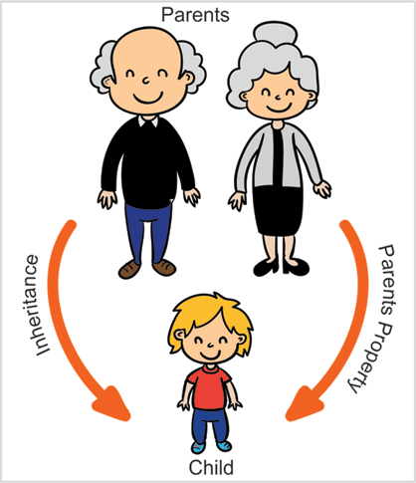
Java Programming – Unit 1
Inheritance

Slide 18
Java Programming – Unit 1
Inheritance can be defined as the process where one class acquires the properties (methods and fields) of another.
With the use of inheritance the information is made manageable in a hierarchical order.
The class which inherits the properties of other is known as subclass (derived class, child class) and
the class whose properties are inherited is known as superclass (base class, parent class).

Slide 19
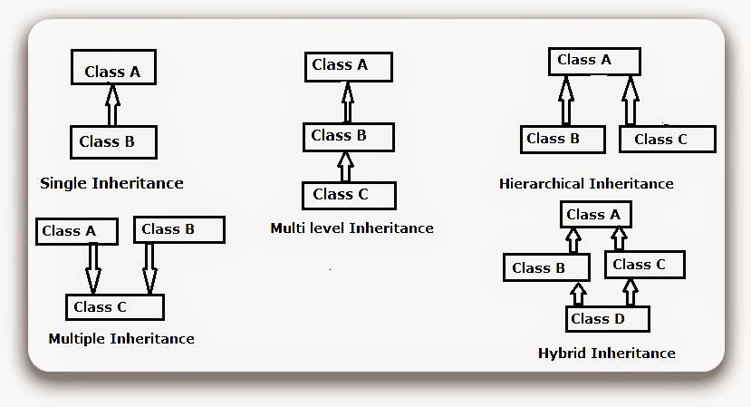
Java Programming – Unit 1
Types of Inheritance

Slide 20
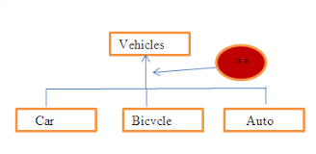
Java Programming – Unit 1
What is Inheritance?
Inheritance: Code reuse using subclass and super class relationship.
Subclass inherits all or some of the members (fields, methods, and nested classes) from its super class.
Inheritance is unidirectional,
It is expressed using “is a “ relationship.
The car is a Vehicle, but all the vehicles are not a car.

Slide 21
Java Programming – Unit 1
Advantages of Inheritance:
There is no multiple inheritance in Java.
One Strong point of Inheritance is that We can use the code of base class in derived class without writing it again.
Inheritance helps to minimize the amount of duplicate code in an application by sharing common code amongst several subclasses.
Reusability -- facility to use public methods of base class without rewriting the same
Extensibility -- extending the base class logic as per business logic of the derived class
Data hiding -- base class can decide to keep some data private so that it cannot be altered by the derived class
Overriding--With inheritance, we will be able to override the methods of the base class so that meaningful implementation of the base class method can be designed in the derived class.

Slide 22
Java Programming – Unit 1
Disadvantages:-
Inheritance in Java requires increased time/effort it takes for the program to jump through all the levels of overloaded classes.
If a given class has ten levels of abstraction above it, then it will essentially take ten jumps to run through a function defined in each of those classes
The two classes (base and inherited class) get tightly coupled.
This means one cannot be used independent of each other.
Also with time, during maintenance adding new features both base as well as derived classes are required to be changed.
If a method signature is changed then it will affect in both cases (inheritance & composition)
If a method is deleted in the "super class" then we will have to re-factor in case of using that method.
Here things can get a bit complicated in case of inheritance because our programs will still compile, but the methods of the subclass will no longer be overriding super-class methods.
These methods will become independent methods in their own right.

Slide 23
Java Programming – Unit 1
Why multiple Inheritance is not allowed in Java?
We always want to extend multiple classes so that we inherits the features of the multiple classes.
For example: class C extends A,B { } but the above declaration is not valid in Java.
In Java ,one class cannot extends from multiple classes.
We can extend only from single class.
But Java supports multilevel inheritance, means it will have multiple ancestors .For example class C extends B{} class B extends A{}

Slide 24
Java Programming – UNIT 1
Refactoring:
http://www.methodsandtools.com/archive/archive.php?id=4

Slide 25
Java Programming – Unit 1
Why Multiple inheritance is not there in Java?
C++ has multiple inheritance.
Java creators thought a lot about to allow the multiple inheritance,
But if a class is extended from two classes and if both parent classes has same method in common
then how the methods will be inherited and
how we will come to know that which method is called of which class.
That is why they excluded the multiple inheritance in Java.

Slide 26
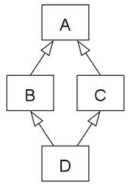
Java Programming – Unit 1
Why Multiple inheritance is not there in Java?
There is a famous problem which is faced during the multiple inheritance application called as "Deadly Diamond of Death".
This is named so because the shape of class diagram which is formed after multiple inheritance implementation.
The diamond is formed when classes B and C extend A ,and both B and C inherit methods from A.
If class D extends both B and C, and both B and C have overridden the methods in class A, class D in theory has inherited the two different implementations of same method.
There is an indirect way by which you can implement the multiple inheritance in Java and this is through extending a class and implementing an interface

Slide 27
Java Programming – Unit 1
Java - Polymorphism
Polymorphism is the ability of an object to take on many forms.
Any Java object that can pass more than one IS-A test is considered to be polymorphic.
It is important to know that the only possible way to access an object is through a reference variable. A reference variable can be of only one type. Once declared, the type of a reference variable cannot be changed.

Slide 28
Java Programming – Unit 1
The reference variable can be reassigned to other objects provided that it is not declared final. The type of the reference variable would determine the methods that it can invoke on the object.
A reference variable can refer to any object of its declared type or any subtype of its declared type. A reference variable can be declared as a class or interface type.

Slide 29
Java Programming – Unit 1
Example:
Let us look at an example.
public interface Vegetarian{}
public class Animal{}
public class Deer extends Animal implements Vegetarian{}
Now, the Deer class is considered to be polymorphic since this has multiple inheritance.
Following are true for the above example:

Slide 30
Access Specifiers
Classes, fields, constructors and methods can have one of four different Java access modifiers:
private.
default (package)
protected.
public.

